Slide 1

WOC7021 DISSERTATION
Proposal Defense
Program: | MCS(AC)
Matric Number: | S2164723
Name: | Wang Meng
Supervisor: | Dr. Suzan Jabbar Obaiys

Slide 2
Image and Text Fusion for Intent Detection in Multimedia

Slide 3
OUTLINE
01
05
Research Methodology
Background
02
06
Significance of research
Problem Statement
03
07
Conclusion
Research Objective & Question
04
08
References
Literature Review

Slide 4
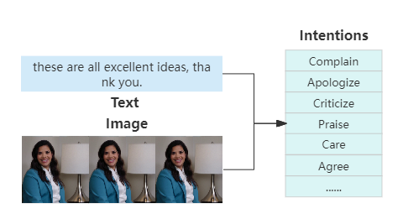
1. Background
As an important research direction in the fields of artificial intelligence and computer science, intent detection is one of the core technologies of human-computer interaction, aims to accurately identify the user's intent from his input to achieve more intelligent services.
An example of intent detection based on text and image fusion.

Slide 5
1. Background
In recent years, with the rapid development of multimedia technology, the forms of information released by users have become more diverse. They usually use text and corresponding picture to express their true intentions more vividly.
Data
The wide application of deep learning technology provides a powerful tool for intent detection, so that the model can better learn and understand the real intent of users from complex massive data.
Tool
Inspired by single-modal pre-training models, a series of Vision-Language pre-training works based on large-scale image-text data have emerged, help us obtain powerful ability of multimodal representation.
Model

Slide 6
2. Problem Statement
At present, there are few studies on intent detection based on image and text fusion, traditional intent detection methods usually only consider single-modal data such as text or images, and do not take full advantage of the rich information of multi-modal data.
Existing research based on image-text information fusion mainly focuses on sentiment analysis and content classification, but there are still significant gaps in interpreting the subtle intentions behind user behavior.
Existing studies mainly focus on the fusion of data from different modalities, while in the feature representation stage, different models are used to extract the features of the corresponding modalities respectively, which limits the model's comprehensive understanding of the global context and increases the complexity of the system.

Slide 7
3. Research Objective & Question
Research Question | Research Objectives
1. How can the Vision-Language pre-training models be leveraged for feature extraction and representation in the field of intent detection? | a. To introduce Vision-Language pre-training models to extract text and image features to achieve multimodal representation.
2. How to develop the proposed intent detection framework? | b. To develop the proposed intent detection framework based on image and text fusion.
3. How can the proposed framework affect the accuracy of intent detection? | c. To evaluate the performance of the proposed intent detection framework by comparing its accuracy with the baseline model.

Slide 8
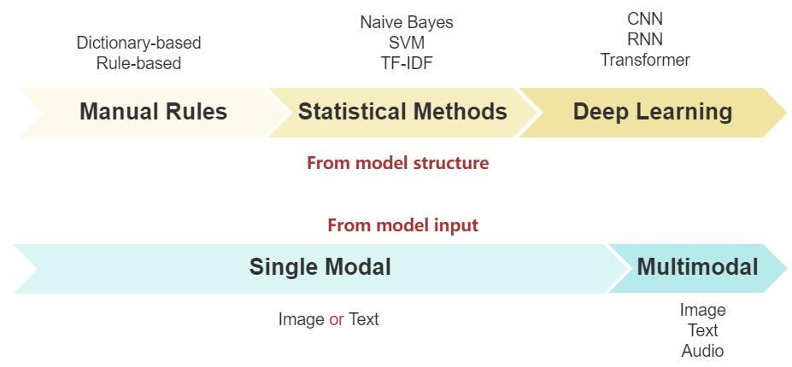
4. Literature Review
Intent Detection

Slide 9
4. Literature Review
Title | Modality | Method | Pros | Cons
Manual Rules
Finding suggestions and buy wishes from product reviews (Ramanand et al. 2010) | Text | Rules Graphs | easy to realize, fast operation speed | high workload, poor stability
Statistical Learning Method
Intent Detection through Text Mining and Analysis (Kruk et al. 2019) | Text | SVM | Automatic pattern, learning Process big data | low efficiency, Manual feature extraction
Deep Learning
Intent recognition model based on sequential information and sentence features (Wu et al. 2024) | Text | CNN BILSTM BERT | Automatic feature extraction and pattern learning | Only text, low efficiency
An effective multimodal representation and fusion method for multimodal intent recognition (Huang et al. 2023) | Text Image Audio | Attention BERT Faster-CNN Wav2vec | High stability, High performance, Accommodate large relations | More complex, Higher computational and storage resources

Slide 10
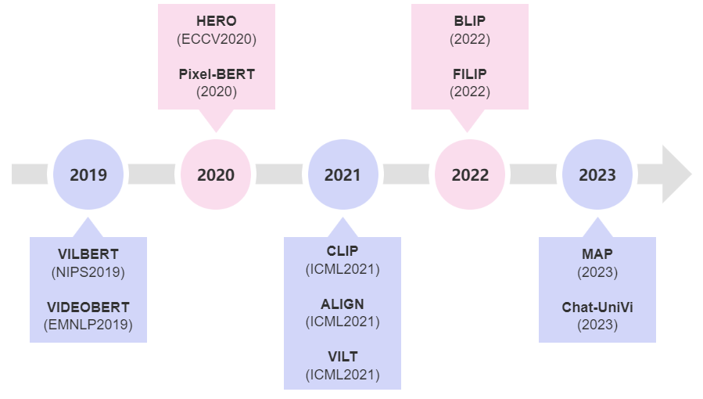
4. Literature Review
Vision-Language Pre-training

Slide 11
4. Literature Review
Model | Modality | Type | Encoder | Datasets
ViLBERT (Lu et al. 2019) | Text-Image | Dual Encoder | BERT + Faster R-CNN | COCO+VG
CLIP (Radford et al. 2021) |  |  | Transformer + Vit | SC
ALIGN (Jia et al. 2021) |  |  | BERT + EffcientNet | AltText
BLIP (Li et al. 2022) |  |  | RoBERTa + ResNet | COCO+VG+CC3M
FILIP (Yao et al. 2022) |  |  | Vit + Vit | CC+FLKR+COCO
MAP (Yatai et al. 2023) |  |  | Transformer + ResNet | VG+CC3M+SBU
PixelBERT (Huang et al. 2020) |  | Fusion Encoder | BERT + ResNet | COCO+VG
ViLT (Kim et al. 2021) |  |  | Vit + Linear Projection | COCO+VG+SBU+CC3M
VideoBERT (Sun et al. 2019) | Text-Video |  | BERT + Faster R-CNN | SC
HERO (Li et al. 2020) |  |  | Transformer | HowTo100M+TV
Chat-UniVi (Peng et al. 2023) | Image-Video |  | Vit + Faster R-CNN | COCO+CC3M

Slide 12
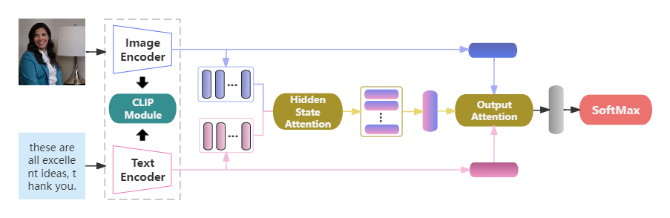
5. Research Methodology
Multimodal Representation
Multimodal Fusion
Classification
Intent detection architecture diagram

Slide 13
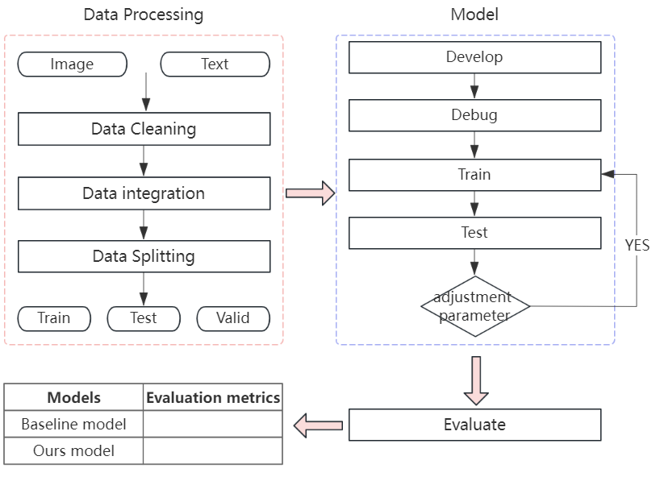
5. Research Methodology
Flow chart of the experiment

Slide 14
5. Research Methodology
Experiment design
Approach | Method | Models | Instruments | Metrics | Dataset
Quantitative | Experiment | Clip, Attention mechanism | Torch | Accuracy, Precision, Recall, F1-Score | MIntRec

Slide 15
6. Significance of research
By analyzing the intention of posts containing image and text information, we can understand the real thoughts of users, thereby providing personalized services such as advertising marketing and public opinion monitoring.
By integrating information from different media for more accurate intent detection, intelligent systems can be provided with a more flexible and natural interaction method, thereby making correct judgments or reasonable feedback on human intentions to improve the quality and efficiency of human-computer interaction.
Social Media
Human-computer Interaction

Slide 16
7. Conclusion
This research endeavors to design a new intent detection framework, which includes two equally important stages of multimodal representation and fusion, to explore the integration of image and text data to enhance the accuracy and robustness of intent detection in multimedia content.
In representation, we propose a representation method based on vision-language pre-training model, which can process image and text data simultaneously to improve the ability of information understanding, and it can also simplify system integration and saves computing resources.
In fusion, we propose an attention-based Cross-modal multi-level fusion method, which can fuse image and text features from token-level and global level, enables the model to dynamically adjust the attention to different modalities, capture important features.

Slide 17
8. References
Ramanand, J., Bhavsar, K., & Pedanekar, N. (2010, June). Wishful thinking-finding suggestions and’buy’wishes from product reviews. In Proceedings of the NAACL HLT 2010 workshop on computational approaches to analysis and generation of emotion in text (pp. 54-61).
Kruk, J., Lubin, J., Sikka, K., Lin, X., Jurafsky, D., & Divakaran, A. (2019). Integrating text and image: Determining multimodal document intention in instagram posts. arXiv preprint arXiv:1904.09073.
Wu, T., Wang, M., **, Y., & Zhao, Z. (2024). Intent recognition model based on sequential information and sentence features. Neurocomputing, 566, 127054.
Huang, X., Ma, T., Jia, L., Zhang, Y., Rong, H., & Alnabhan, N. (2023). An Effective Multimodal Representation and Fusion Method for Multimodal intention detection. Neurocomputing, 126373.
Lu, J., Batra, D., Parikh, D., & Lee, S. (2019). Vilbert: Pretraining task-agnostic visiolinguistic representations for vision-and-language tasks. Advances in neural information processing systems, 32.

Slide 18
8. References
Radford, A., Kim, J. W., Hallacy, C., Ramesh, A., Goh, G., Agarwal, S., ... & Sutskever, I. (2021, July). Learning transferable visual models from natural language supervision. In International conference on machine learning (pp. 8748-8763). PMLR.
Jia, C., Yang, Y., **a, Y., Chen, Y. T., Parekh, Z., Pham, H., ... & Duerig, T. (2021, July). Scaling up visual and vision-language representation learning with noisy text supervision. In International conference on machine learning (pp. 4904-4916). PMLR.
Huang, Z., Zeng, Z., Liu, B., Fu, D., & Fu, J. (2020). Pixel-bert: Aligning image pixels with text by deep multi-modal transformers. ar**v preprint ar**v:2004.00849.
Kim, W., Son, B., & Kim, I. (2021, July). Vilt: Vision-and-language transformer without convolution or region supervision. In International Conference on Machine Learning (pp. 5583-5594). PMLR.
Sun, C., Myers, A., Vondrick, C., Murphy, K., & Schmid, C. (2019). Videobert: A joint model for video and language representation learning. In Proceedings of the IEEE/CVF international conference on computer vision (pp. 7464-7473).

Slide 19
Thank You for Your Listening
Question and Answer

